Slide 1

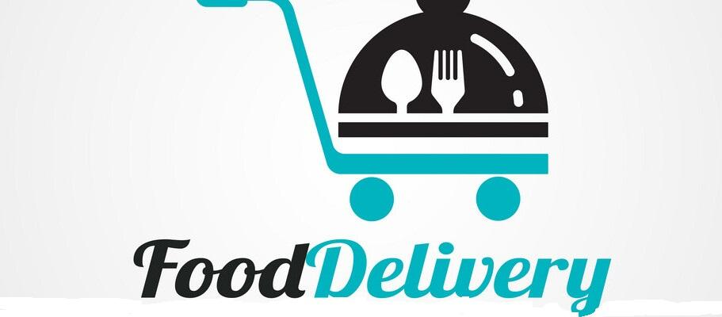
Food Delivery System
By:
To: Prof. Mohammed J. Alhaddad

Slide 2
Why We Chose Food Delivery?
Since the outbreak of COVID-19, many business and projects have either shutdown or turned to an online services
And because of that, the online service has become very needed than ever by businessmen
Food delivery service is one of those services that become very popular and successful business during COVID-19, that why we chose it!

Slide 3
What Our System Do?
This system has three important actors: Admin, Customer and Delivery man.
The system provide a list of food for costumer to order, and then send the order (after confirming) to database, then the delivery man check the orders’ list and choose one to deliver.
The admin manages costumers, delivery and food data in the system. The admin can insert, delete and update the database by the system interface.

Slide 4
Methodology Used For The System
We have decided to use RAD Methodology for our system for a number of reasons:
The use of prototyping, it will be useful for us because of the feedback of user.
We can write the software much faster because we’ll spend less time in planning.
We can change the requirements way easier & faster.
This methodology decreases the time of design and implementation.

Slide 5
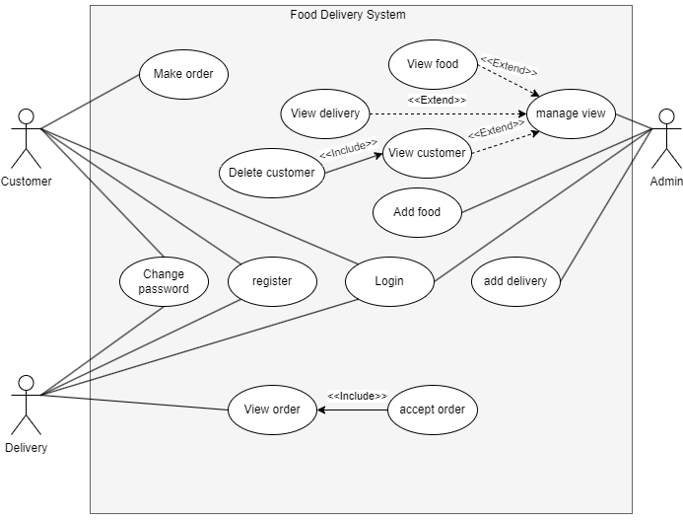
Use-case Diagram

Slide 6
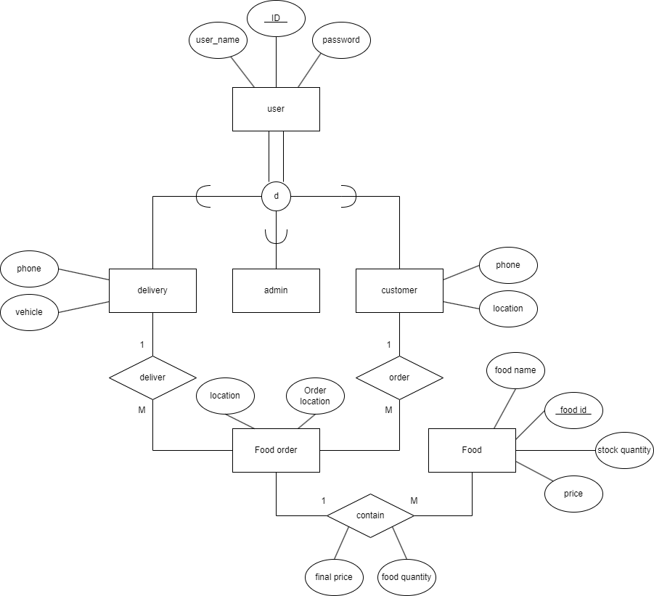
The ER Diagram For The System

Slide 7
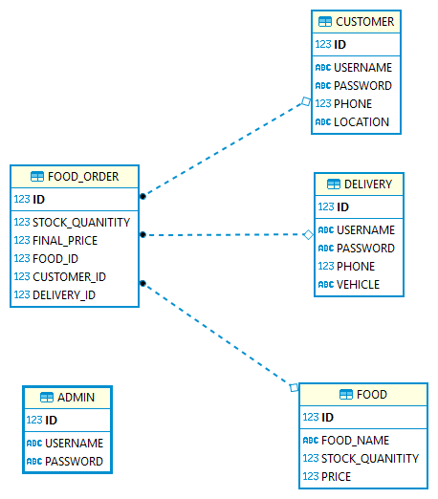
The ER Diagram For The System(continue)

Slide 8
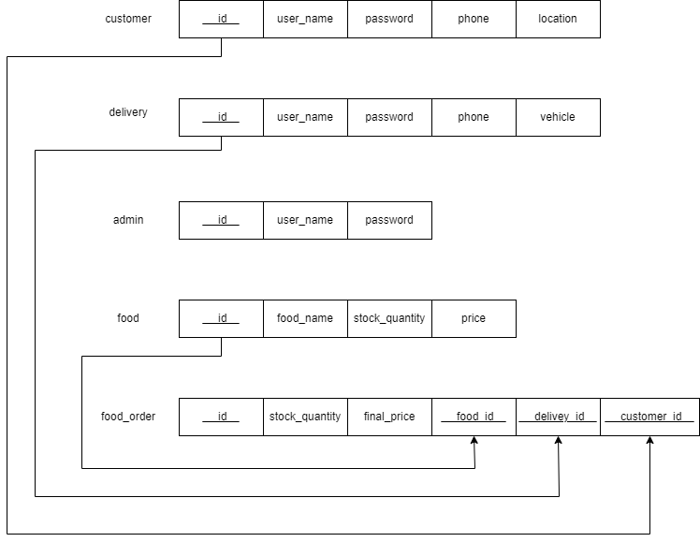
The Schema Of The ER

Slide 9
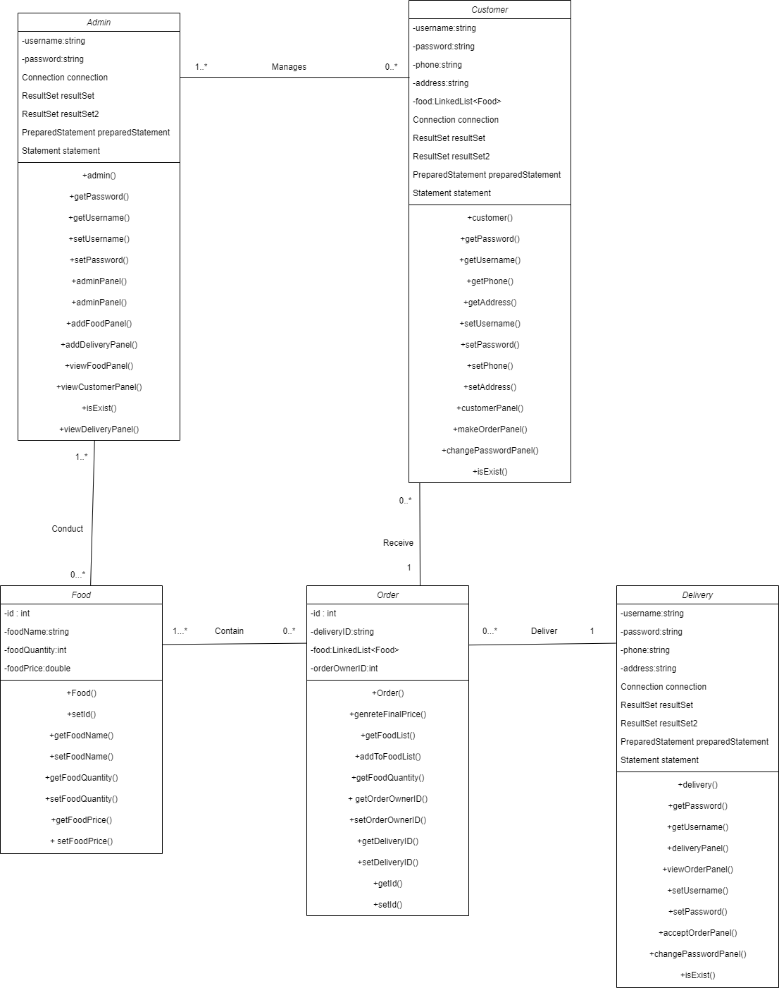
The Class Diagram

Slide 10
The 4-Functions’ Interfaces

Slide 11
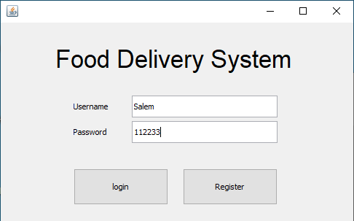
Login’s Interface

Slide 12
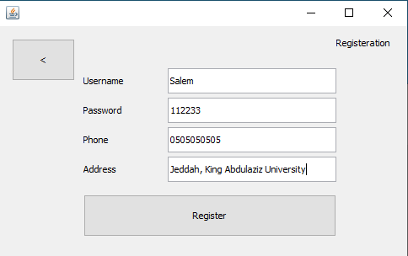
Register’s Interface

Slide 13
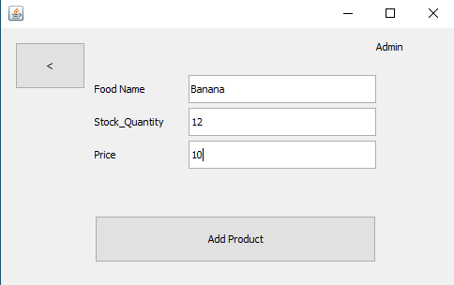
Add food’s Interface

Slide 14
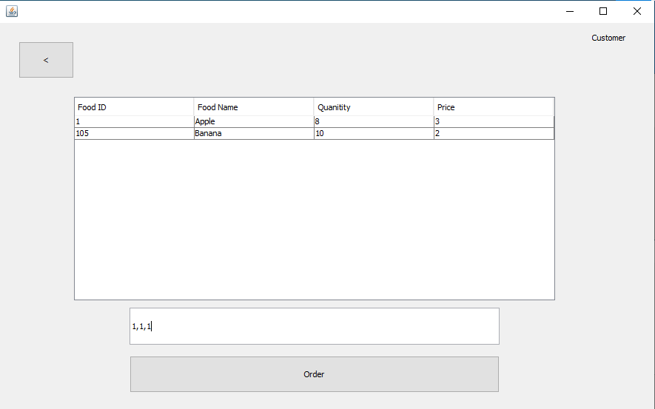
Make order’s Interface

Slide 15
Thank you for
Listening

